Slide 1


Slide 2
Types of Modules in FastAPI:
1. Core Modules (Built-In): These are modules that are included with Python and provide basic functionality. Examples os, math, datetime, json, random.
2. Local Modules: These are modules that you create in your Python application. You can create a local module by defining a Python file.
3. Third-party Modules: These are modules created by third-party developers and are not included with Python. You can install third-party modules using pip (Node Package Manager) and then use import to include them in your application.

Slide 3
1. Core Modules :
In Python, Core Modules are the built-in modules that come pre-installed with Python. These modules provide essential functionalities for building applications and eliminate the need for additional installation. They are designed to perform various tasks such as file handling, HTTP operations, cryptography, stream handling, and more.
Key Features of Core Modules
No Installation Needed: Core modules are part of the Python runtime and can be used directly without installing any additional packages.
Global Availability: Core modules can be imported and used in any Node.js application.
Common Core Modules: os, math, datetime, json, random & etc

Slide 4
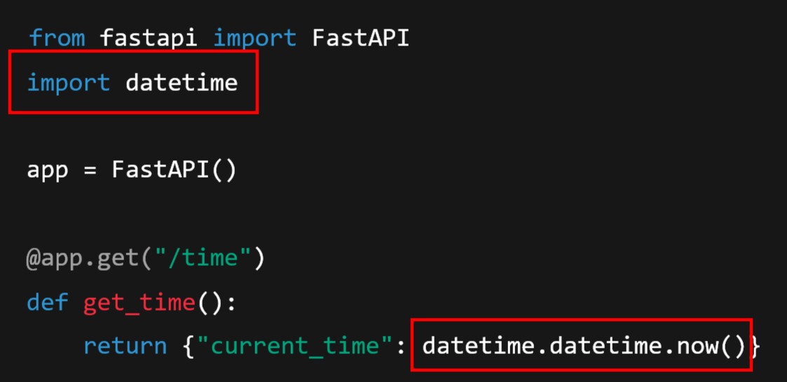
Using Core Modules:
To use a core module Python, you import it using the import Keyword:

Slide 5
2. Local Modules:
Local Modules in Pythonare custom modules created by developers to encapsulate specific functionality within their applications. Unlike core modules (built into Python) or third-party modules (installed via pip), local modules are part of your project, often created to organize and reuse code.
Characteristics of Local Modules:
Custom-built: Designed to address specific requirements of the application.
Reusable: Can be imported and used across different parts of the project.
File-based: Each local module corresponds to a Python file or a set of files in your project

Slide 6
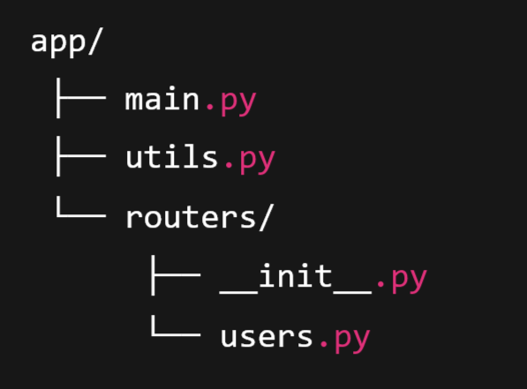
Creating a Local Module:
A local module is just a Python file where you define your functionality
Example Project Structure:

Slide 7
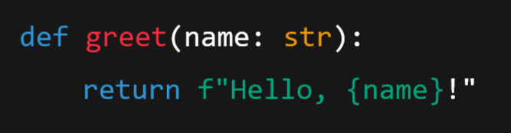
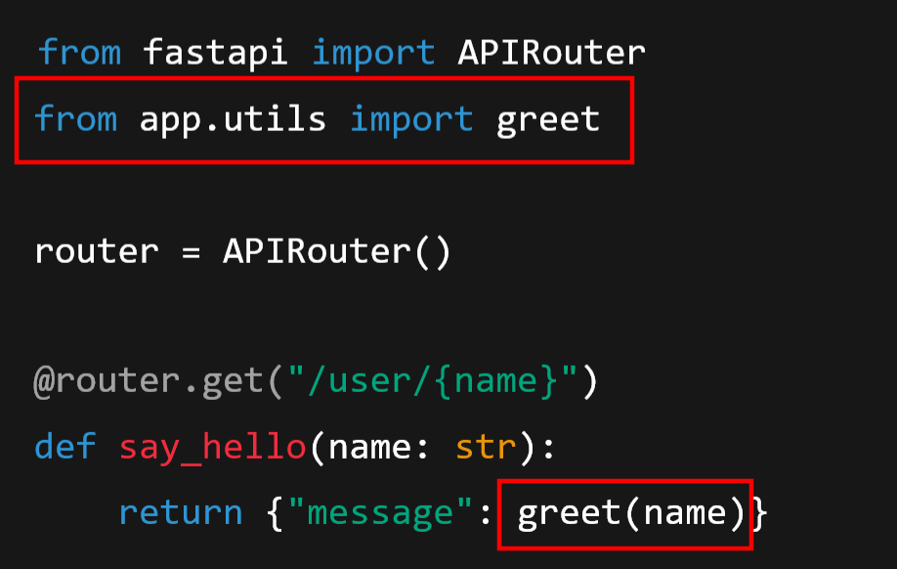
utils.py:
users.py

Slide 8
3. Third-party Modules:
Third-party modules in Python are external packages created by the developer community and published to the PYPI (Python Package Index) repository. These modules extend the functionality of Python, allowing developers to use pre-built solutions instead of writing everything from scratch.
Characteristics of Third-party Modules
Community-driven: Developed and maintained by the Python community or organizations.
Installable via npm: Available in the pip registry and installed using the pip command-line tool.
Reusable: Can be used across multiple projects.
Versioned: Versions are maintained to ensure stability and compatibility.
Examples of Popular Third-party Modules: fastapi, uvicorn, Pandas, numpy, etc.

Slide 9
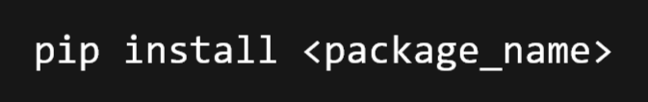
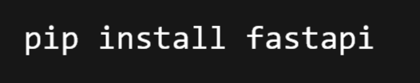


How to Use Third-party Modules:
1. Install the Module: Use pip install to add the module to your project:
2. Import the Module: Import the module in your Python file using import:
3. Use the Module: Call the functions or use the classes provided by the module in your application.

Slide 10
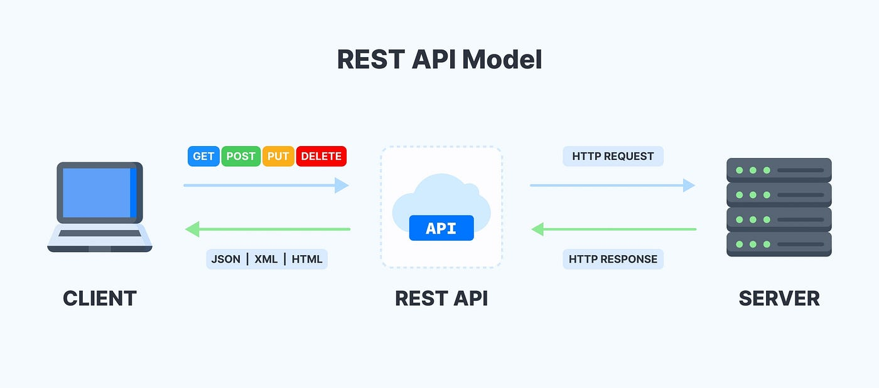
Client Request Data in

Slide 11
Types of Request Data
Following are the different ways a client can send data to a FastAPI server
Path or URL Parameters
Query Parameters
Request Body (JSON)
Request Header
Cookies
Form Data
File Uploads

Slide 12
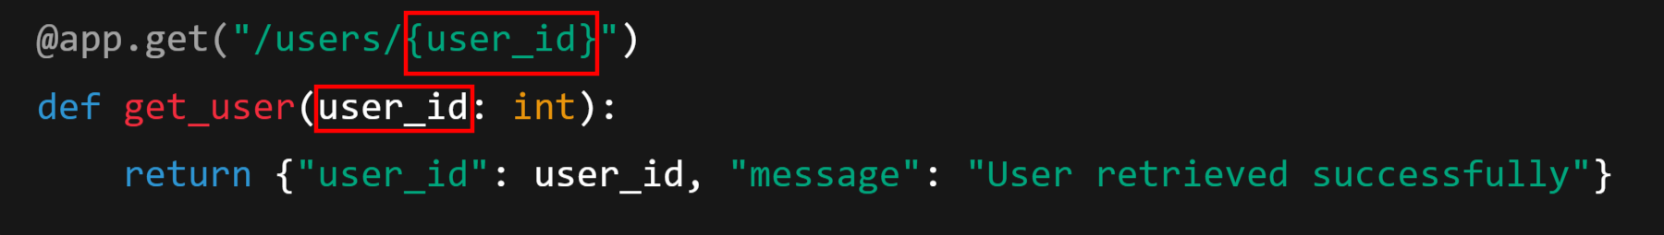
1. Path or URL Parameters:
Path parameters are part of the URL path itself — useful for resource identifiers.
Where,
URL: http://127.0.0.1:8000/users/101
Here 101 is passed as user_id (an integer).
Used when you want to identify a specific resource, like /orders/123 or /products/5.

Slide 13
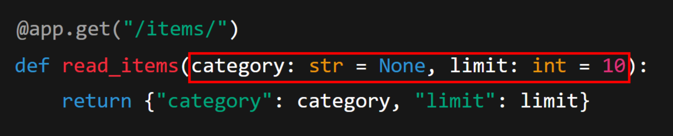
2. Query Parameters
Query parameters appear after the ? in the URL and are ideal for filtering, searching, or pagination.
Here,
URL: http://127.0.0.1:8000/items?category=books&limit=5
Both parameters are optional here.
FastAPI automatically converts types (like limit to int).
Great for filtering and controlling API responses.

Slide 14
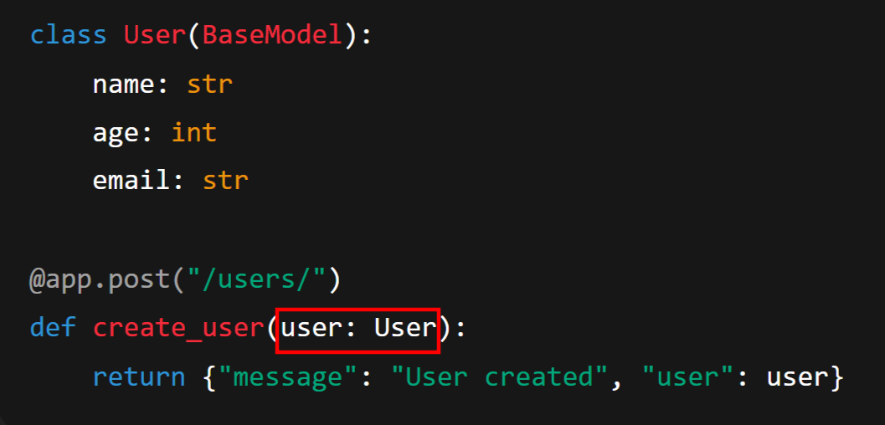
3. Request Body (JSON Data)
When you send structured data (usually via POST or PUT), you typically send it in the body as JSON. FastAPI automatically parses it into a Pydantic model or Python dict.
Example:

Slide 15
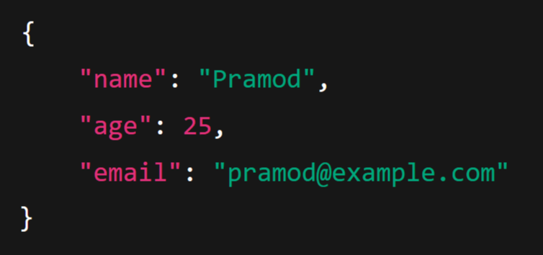
Here:
Client sends:
FastAPI automatically validates and converts JSON to the User model.
Ideal for complex structured data.

Slide 16
4. Headers:
Headers carry metadata about the request/response — things like Authorization, Content-Type, Accept, User-Agent, caching info, and custom app-level data (e.g. X-Request-ID). Use them for auth tokens, client hints, versioning, feature flags, tracing, and controlling response behavior.
How to read request headers
Using Header (recommended for specific headers)
Using Request to access all headers

Slide 17
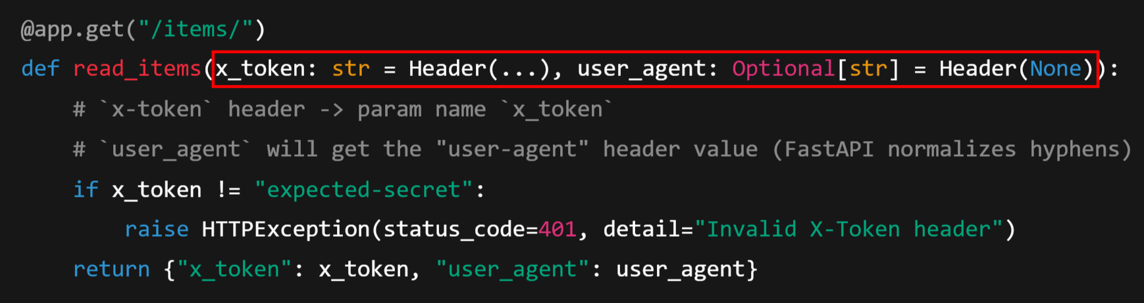
1) Using Header (recommended for specific headers)
Header works well when you expect a particular header (required or optional). FastAPI will validate & convert types.

Slide 18
Note:
Header names are case-insensitive. FastAPI converts header names with hyphens to underscores in Python parameter names (X-Token → x_token).
Use Header(...) to mark a header required; Header(None) makes it optional.
Here … Ellipsis used to mark the parameter as required — just like required=True in other frameworks.
You can provide alias if you want a different Python name vs header name.

Slide 19
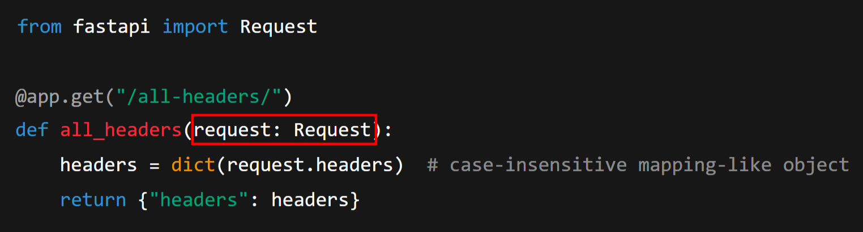
2. Using Request to access all headers
If you need raw access to all headers or dynamic names:

Slide 20
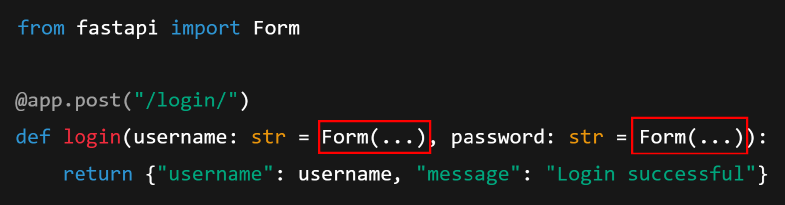
5. Form Data
Used when clients (like HTML forms) send data using the application/x-www-form-urlencoded or multipart/form-data content types.
Example

Slide 21
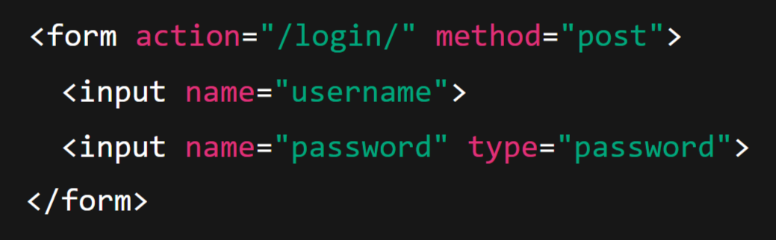
Here:
Client HTML form:
Data is not JSON — it’s encoded as key-value pairs in the request body.
Used mainly for traditional form submissions.

Slide 22
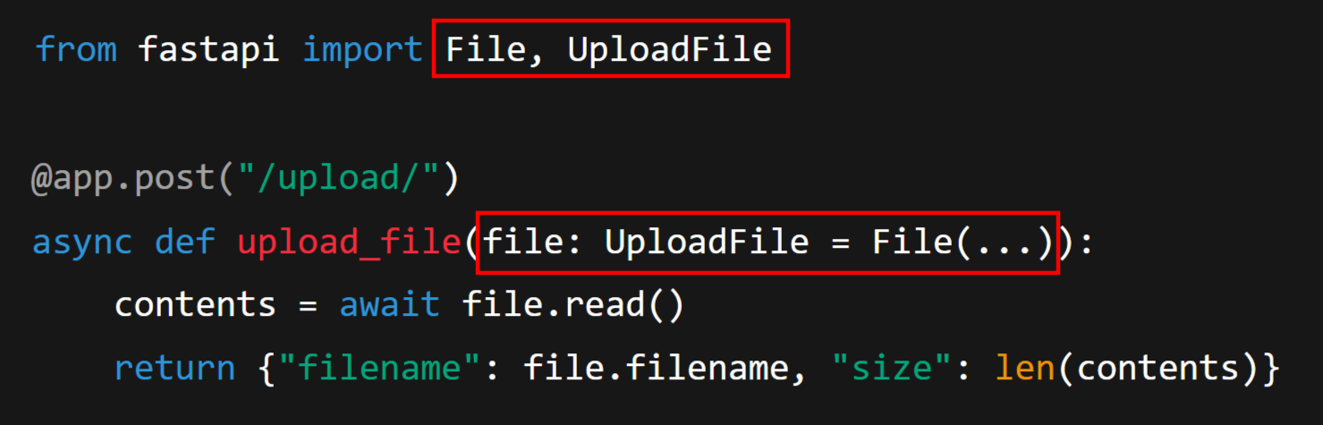
6. File Uploads
When sending files, you use multipart/form-data. FastAPI makes this easy with the File class.
Example

Slide 23
Here:
Client sends a file (like from a form).
UploadFile gives you:
file.filename
file.content_type
.read() or .write() to handle content.
Useful for profile pictures, documents, etc.

Slide 24
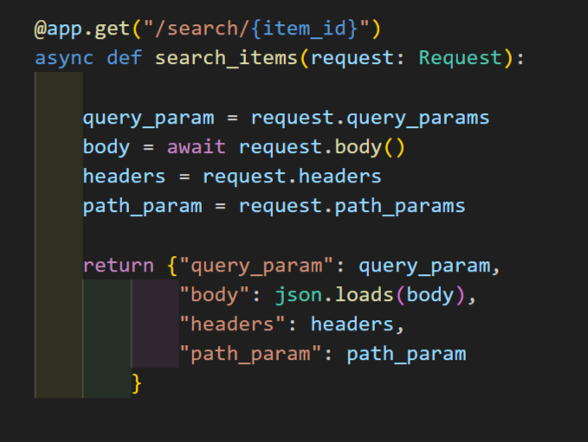
Request Object:

Slide 25
Middleware
Middleware is a layer that sits between the client request and your route handlers (endpoints). It can:
Inspect or modify the request before it reaches your endpoint.
Inspect or modify the response before it goes back to the client.
Perform tasks like logging, authentication, metrics, CORS, compression, etc.
Think of it like an onion 🧅:
The request enters through several middleware layers, reaches your endpoint, and then travels back through the same layers as a response.

Slide 26
Middleware Flow
Client sends a request → enters the middleware stack.
Each middleware can:
Run logic before passing to the next handler.
Optionally stop the chain (e.g., reject request).
After your route runs and returns a response, each middleware can:
Modify the outgoing response.
Finally, the response is sent back to the client.

Slide 27

How Middleware Works in FastAPI (or Starlette)
In FastAPI, middleware must be asynchronous and accept:
request: the incoming Request object.
call_next: a function that passes the request to the next handler (and eventually your endpoint). It returns a Response.
Example:

Slide 28
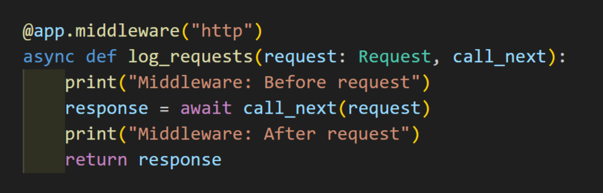
Example:
Note: Every request to any route passes through this middleware.

Slide 29
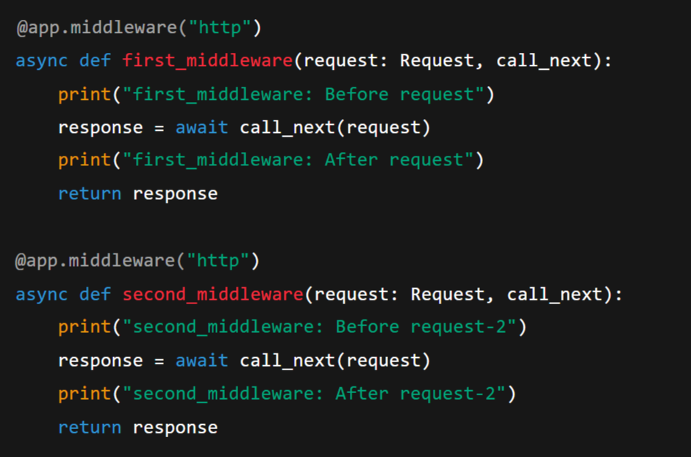
Multiple Middleware's:

Slide 30
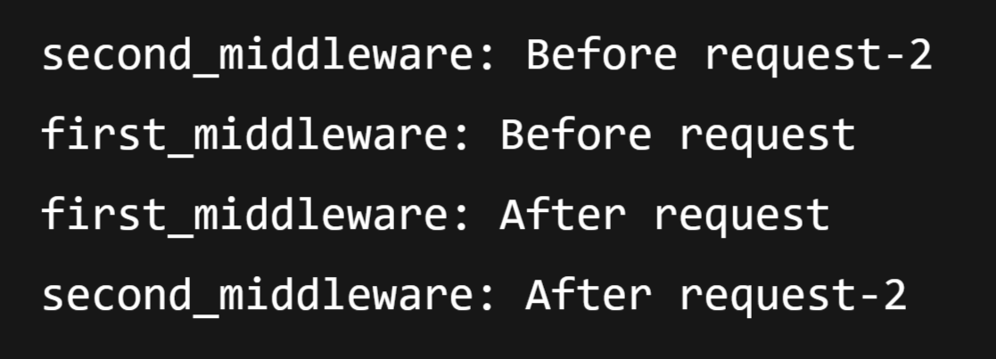
Output:
Note:
The last middleware you declare in code becomes the outermost layer and runs first on the way in (request), and last on the way out (response).
This is because FastAPI builds the middleware chain in reverse declaration order — each new @app.middleware("http") wraps around the previous stack.

Slide 31
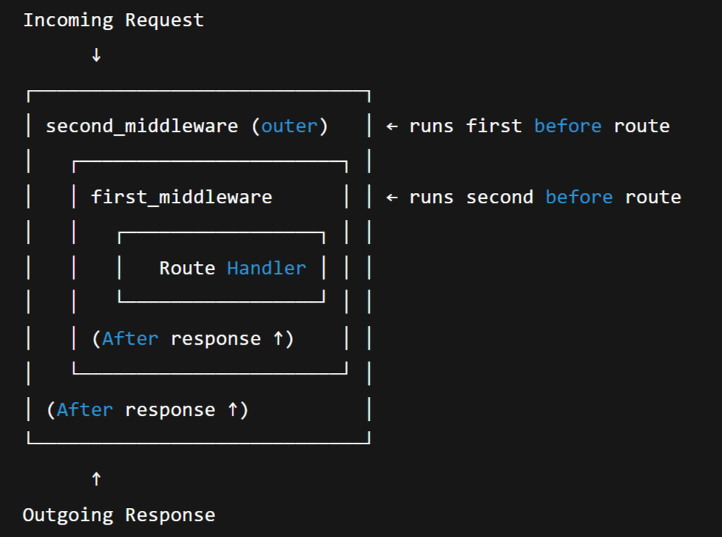

Slide 32
Types of Middleware:
1. Application-Level Middleware (Custom Middleware)
Defined directly in your FastAPI app using @app.middleware("http") Decorator.
These are custom middleware that you write for your own logic such as:
Logging requests/responses
Modifying headers
Handling custom authentication
Measuring execution time
Example: Logging Request/Response

Slide 33
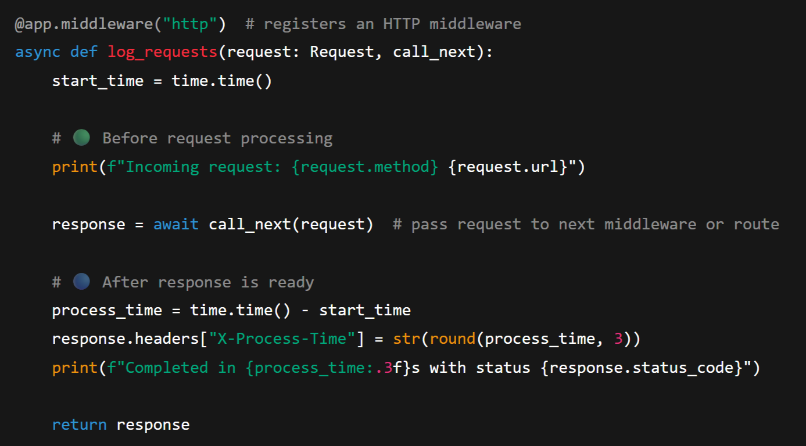
s

Slide 34
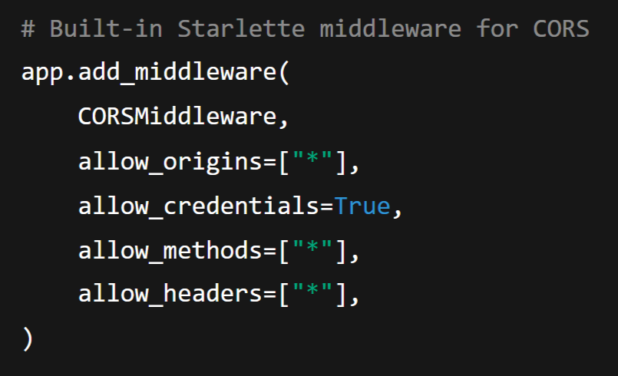
2. Third-Party or Built-in Middleware (Starlette Middleware)
These are middleware classes that come from Starlette (the framework under FastAPI) or third-party libraries.
They are added using app.add_middleware().
Example:

Slide 35
Dependency Injection
Dependency Injection (DI) is a software design pattern that allows you to inject external components or reusable logic into your path operations (endpoints), instead of hardcoding them inside every function.
In FastAPI:
A dependency is just a function (or class) that FastAPI calls for you automatically.
You can reuse dependencies across routes.
They can perform common logic (e.g., database connection, auth, config, validation, etc.)

Slide 36
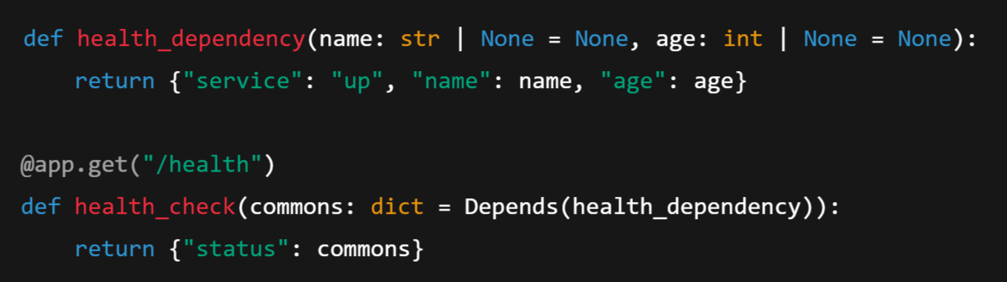
Example:

Slide 37
1. Depends(health_dependency)
Depends is a FastAPI dependency injection mechanism.
It tells FastAPI: “Before running the health_check() endpoint, call health_dependency() and pass its return value as the argument commons.”
2. How FastAPI passes parameters (name, age)
FastAPI automatically looks for parameters of the dependency function (name and age) in the HTTP request:
Query parameters (e.g., /health?name=Pramod&age=25)
Form data
Headers
Path parameters
If it finds them, it passes them in.
If not, it uses their default values (None here).

Slide 38
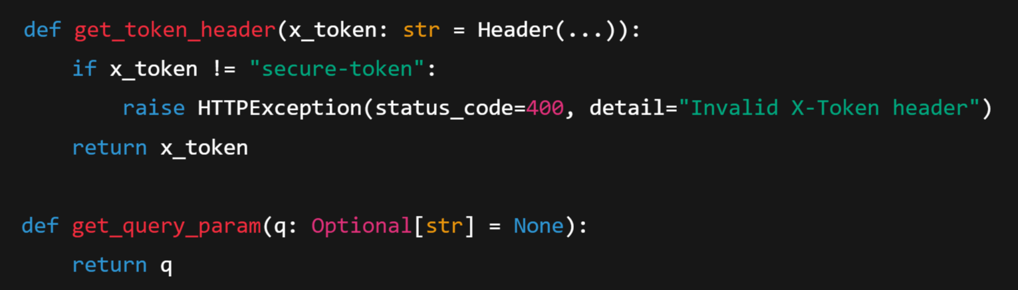
Example 2: Using Multiple Dependencies

Slide 39
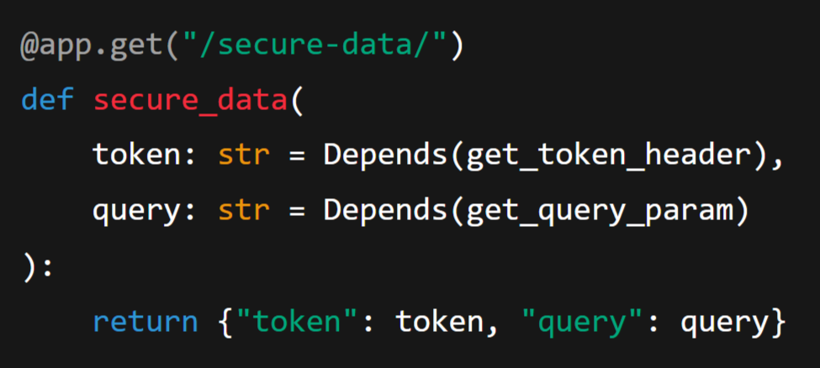
Endpoint:

Slide 40
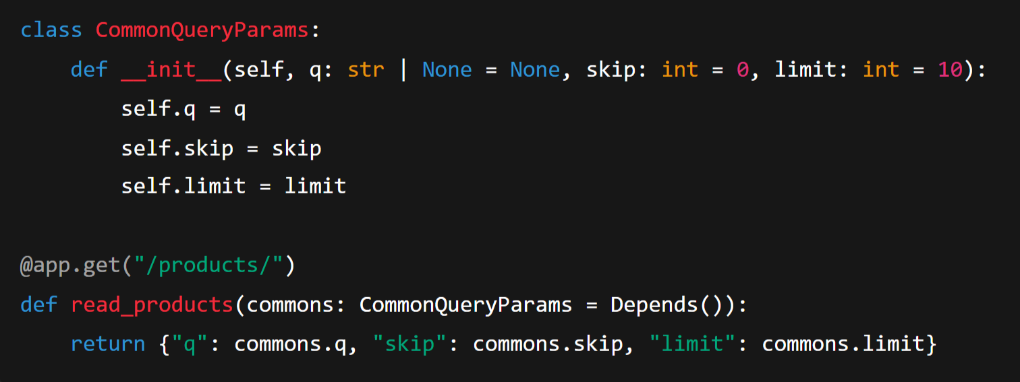
Example 3: Class as a Dependency
We can also make dependencies classes — very useful for stateful or structured logic.

Slide 41
Here:
FastAPI automatically:
Instantiates CommonQueryParams
Extracts query params from the request
Injects the instance into your route

Slide 42
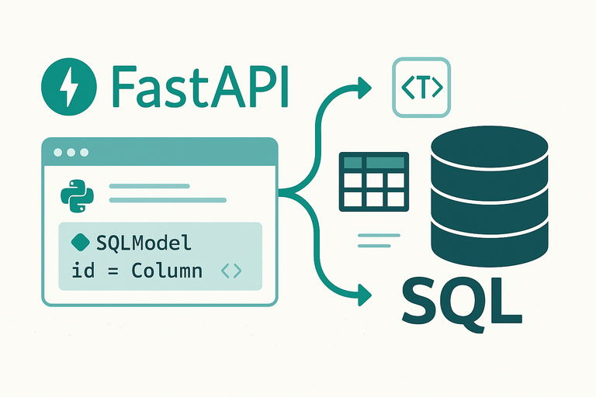

Slide 43

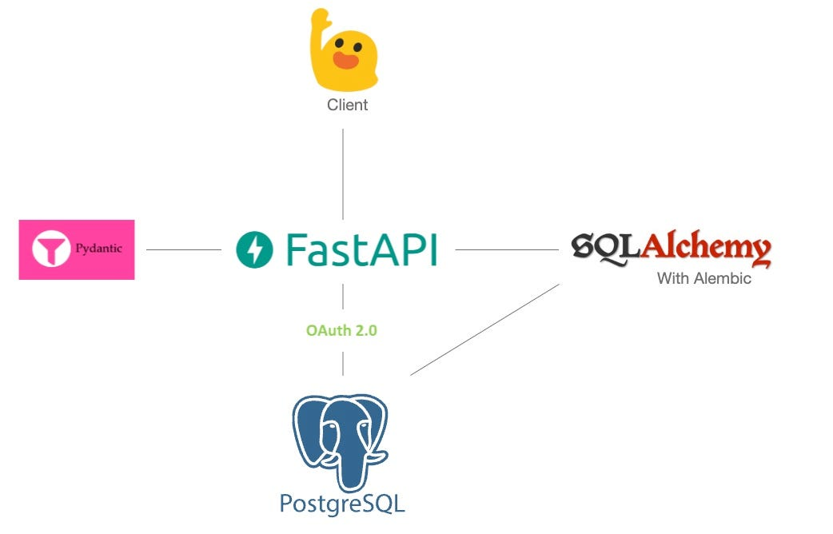

Slide 44

PostgreSQL:
PostgreSQL (often called Postgres) is an open-source, powerful, and advanced relational database management system (RDBMS). It is used to store, organize, and retrieve structured data efficiently and reliably.
It stores data in tables (rows and columns) and supports SQL for queries.
PostgreSQL is an object-relational database management system (ORDBMS) that uses SQL (Structured Query Language) for defining and manipulating data.
Key Features of PostgreSQL:
Open Source
Cross-platform
ACID Compliant
Strong Security

Slide 45
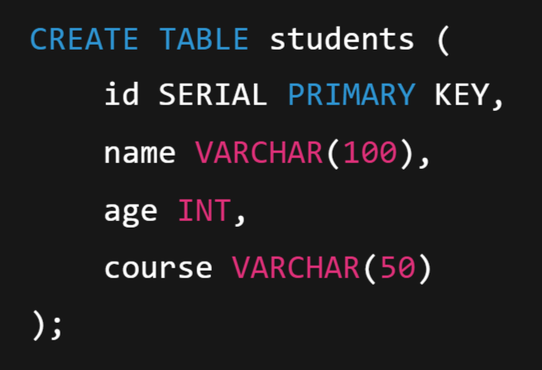
Example: Basic SQL in PostgreSQL (CRUD)
1. CREATE TABLE:

Slide 46
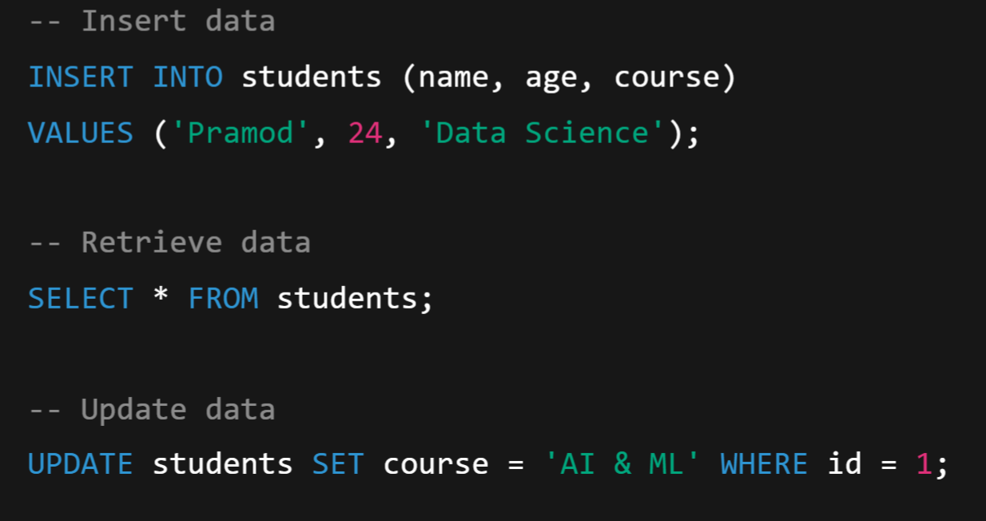

2. INSERT:
3. SELECT
4. UPDATE
5. DELETE:

Slide 47
FastAPI + PostgreSQL Integration:
Why Do We Need a Real Database?
When we use an in-memory list or dictionary:
Data disappears when the app restarts.
Concurrency (multiple users) isn’t handled.
No query optimization or indexing.
No relationship between data.
👉 To make the data persistent, reliable, and scalable, we need a database system.
PostgreSQL is ideal because it’s:
Open-source
SQL-compliant
Highly reliable
Works well with FastAPI and SQLAlchemy

Slide 48

What is SQLAlchemy?
SQLAlchemy a Python library and ORM that helps you interact with relational databases (like PostgreSQL) using Python classes and objects, instead of writing raw SQL queries.
Simple Analogy
Without ORM: We speak to the database in SQL.
With ORM: We speak to the database in Python — and SQLAlchemy translates it to SQL for you.
SQLAlchemy is a Python library that helps us talk to databases easily.
Think of it as a translator between:
Python (which we understand)
SQL (which the database understands)
👉 Without SQLAlchemy, we’d have to write SQL commands.

Slide 49
Why ORM?
Traditional SQL | ORM (SQLAlchemy)
You manually write INSERT, SELECT, UPDATE queries. | You create, read, and update Python objects.
You need to manage table joins, schema changes, and SQL syntax. | ORM handles relationships, joins, and schema automatically.
Harder to maintain large applications. | Easier, cleaner, and object-oriented.

Slide 50
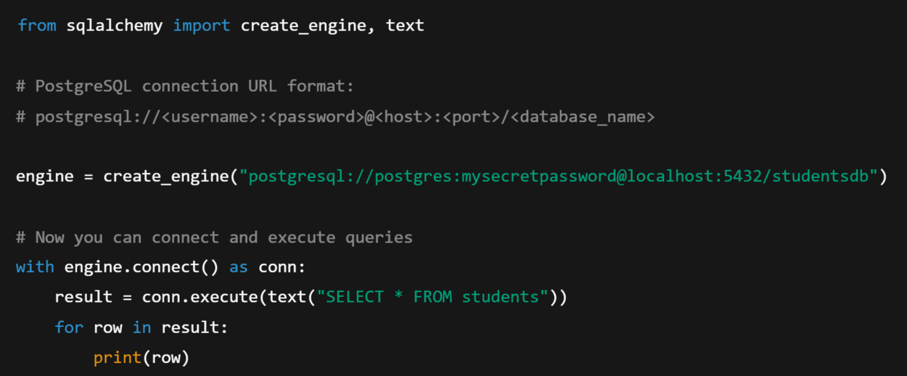
SQLAlchemy Layers: SQLAlchemy has two main parts:
Core (Low-level) — lets you write SQL-like statements in Python directly.

Slide 51
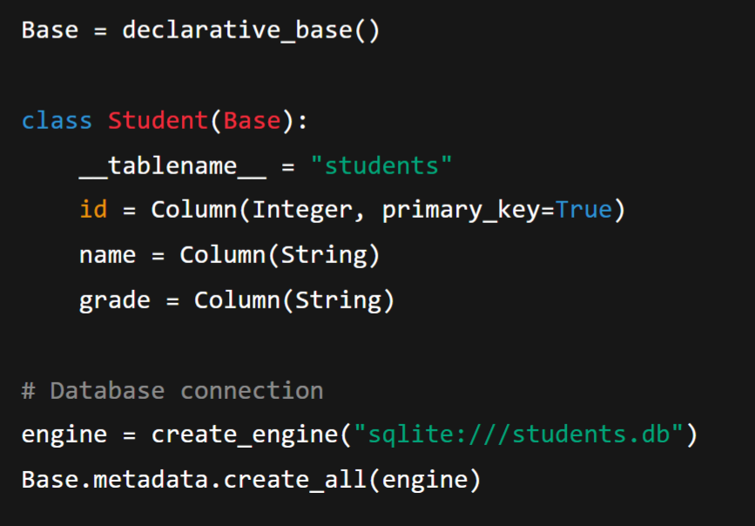
2. ORM (High-level – Object Relational Mapper) — maps Python classes → database tables.

Slide 52
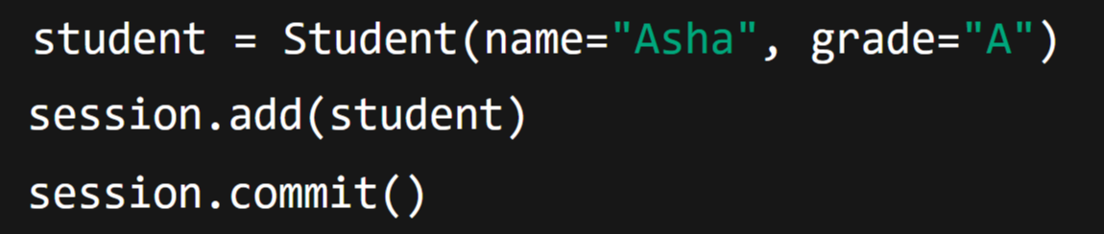
ORM (Object Relational Mapper) in SQLAlchemy
ORM is the heart of SQLAlchemy.
It allows you to interact with your database using Python classes and objects instead of writing raw SQL queries.
In simple words: Without ORM 👇We use:
With ORM 👇We just write:
ORM automatically converts your Python code into SQL statements behind the scenes.

Slide 53
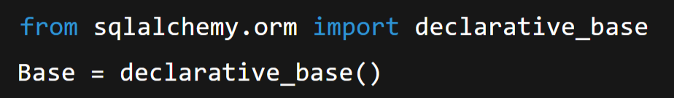
How ORM Works — Step-by-Step:
Define a Base Class
Every ORM model (table) should inherit from a Base class.
This base class tells SQLAlchemy: “Any class that inherits from me is a database table.”

Slide 54
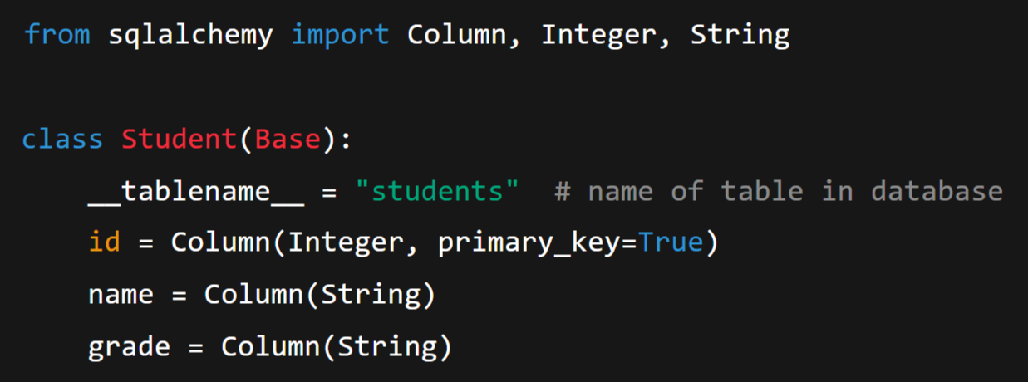
2. Define a Model (Table)
Each class in Python represents a table in the database.
Each attribute in the class represents a column.

Slide 55
So:
Table name → students
Columns → id, name, grade
Each object of Student → one row in that table.

Slide 56
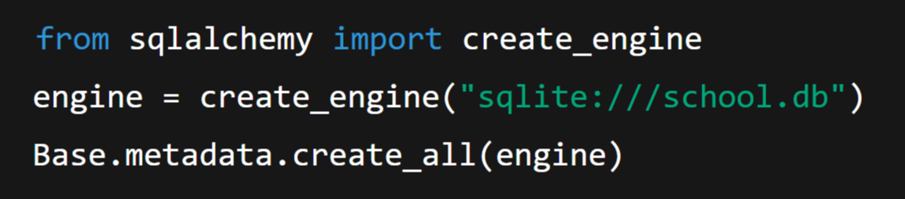
3. Create the Database Table
This line creates the table in your database automatically — no need to write SQL manually.

Slide 57
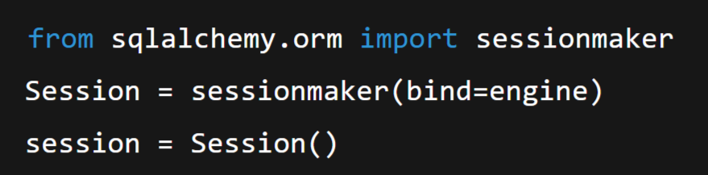
4. Create a Session (for talking to DB)
The Session is the ORM’s way of communicating with the database.
Think of it as a temporary workspace where you can:
Add new data
Query data
Update data
Delete data

Slide 59
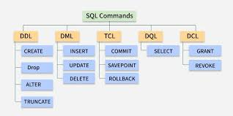

Slide 60
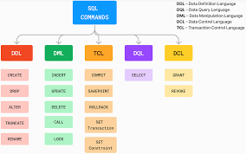

Slide 61
Key ORM Concepts
Concept | Description
Engine | Connects SQLAlchemy to your actual database (PostgreSQL, SQLite, etc.)
Session | Temporary workspace for talking to the database (like a browser session).
Model (Class) | Represents a database table.
Instance (Object) | Represents one row in the table.
Base | Common class that all ORM models inherit from.
Query | A way to fetch or modify data (e.g., session.query(User).all()).

Slide 62
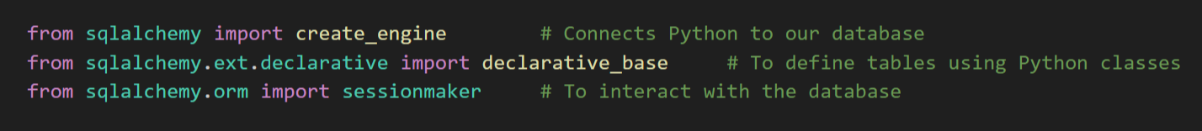
Example:
Step 1: Install the Package:
Step 2: Create a database.py file
Import:

Slide 63
Connection string
This line tells SQLAlchemy where your database is and how to log in. Think of this as a home address for your database — it tells Python exactly where to knock!
Part | Meaning
postgresql:// | Type of database (PostgreSQL)
postgres | Username used to log in
Monday%40123 | Password (@ is encoded as %40)
localhost | The database is running on the same computer
/ROOKIES | The name of the database you want to connect to

Slide 64
Create the engine
This creates a connection engine — the tool that actually talks to PostgreSQL.
Imagine engine as the bridge that connects Python to your database.
Every time the app wants to run a query, it goes through this engine.
Create a session:

Slide 65
A session is like opening a document to edit:
You open it (start a session)
Make your changes (insert, update, delete)
Then save (commit) or discard (rollback)
This line creates a factory (SessionLocal) that can make new sessions whenever you need them.
Parameter | Meaning
bind=engine | Tells sessions which database connection to use
autocommit=False | You must save changes manually (safer)
autoflush=False | Prevents automatic sending of changes before commit

Slide 66
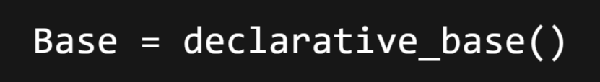
Create the Base class
This is the starting point for creating database tables.
Later define classes (like User, Product, etc.) that inherit from Base.
Each class becomes a table in the database.
Think of Base as a parent blueprint — every new table will be a “child” of this base.

Slide 67
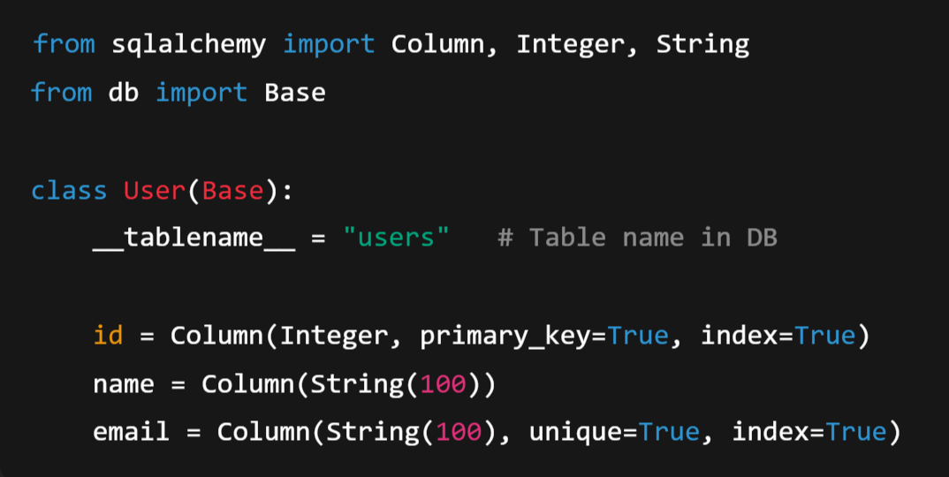
Step: 3 Define a Model (a table) → models.py

Slide 68
Where,
User class represents the users table.
Each attribute → column in PostgreSQL.
id, name, email → become columns in the table.
Base → Comes from the previous setup (declarative_base()), acts as a blueprint for creating database tables.

Slide 69
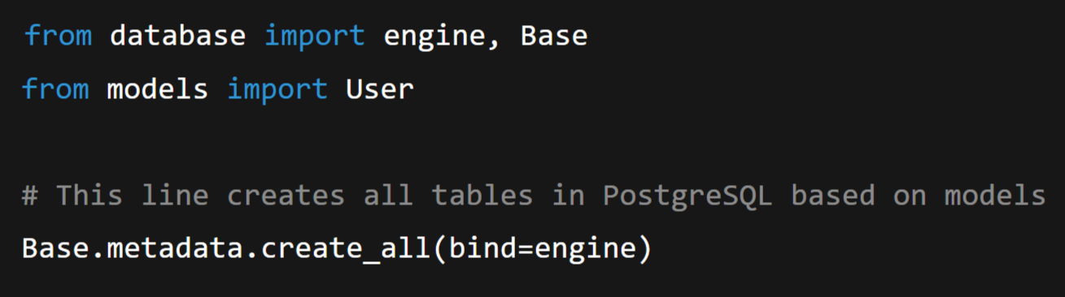
Step 4 : Once your model is defined, you can actually create the table in your database using:

Slide 70
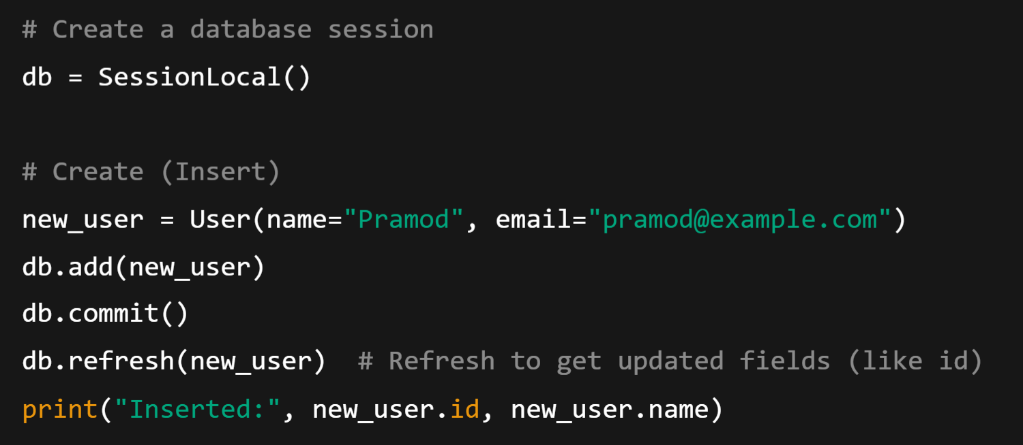
Step 5: Opens a database session, and do the CRUD Operation

Slide 71
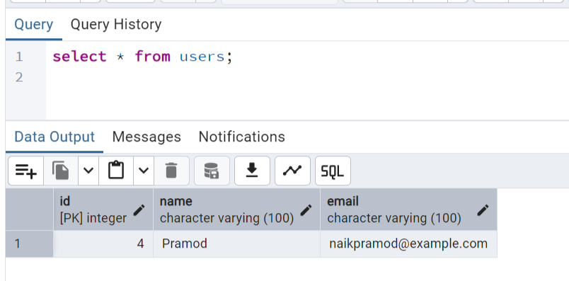
Step 6: Check the PostgreSQL DB
Now there should be a table named Users with one Row

